Slide 1
Heaps
Leftist Trees
&
Binomial Queues Details

Slide 2
Leftist Trees
Heaps are very efficient in terms of space. The array implementation requires no additional pointers.
However in some applications we want to merge 2 Priority Queues, without inserting every element of one heap into the other. For this we need a new implementation.

Slide 3
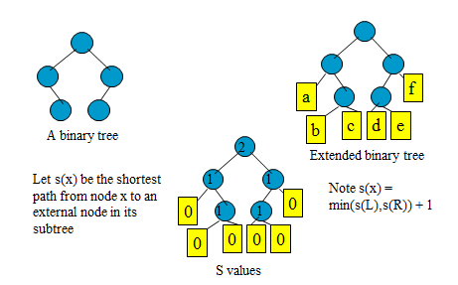
External Trees
Consider a binary tree in which a special node called an external node replaces each empty subtree (the terminal nodes)
The remaining nodes are called the internal nodes
A binary tree with external nodes is called an extended binary tree.

Slide 4
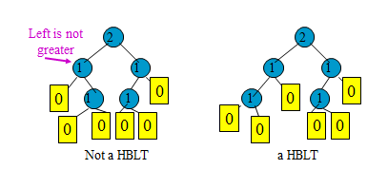
Height-Biased Leftist Tree (HBLT)
Definition: A binary tree is a height-biased leftist tree (HBLT) if and only if at every internal node, the s value of the left child is greater than or equal to the s value of the right child.
Theorem Let x be any internal node of a HBLT
The number of nodes of the subtree with root x is at least 2^{s(x)} –1
If the subtree with root x has m nodes, s(x) is at most lg(m+1)
The length of the rightmost path from x to an external node is s(x)

Slide 5
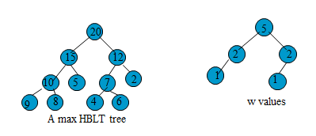
Max(Min) HBLT’s
Definition: a max HBLT is a an HBLT that is also a max tree. (recall this means the data root of every subtree is greater than the data in either of its children.)
Instead of shortest path to the external nodes a binary tree is weight-biased leftists tree (WBLT) if and only if at every internal node, the w value of the left child is greater than or equal to the w value of the right child. (w value is the # of internal nodes in the subtree.)

Slide 6
Operation of a Max HBLT
Note that right side of a leftist tree has height of at most lg(n)
So if we at worst traverse that path we can do operations in Θ(lg(n)) time
Meld – combines 2 Max HBLTs into 1 - Θ(lg(n))
Insert (make the new element a Max HBLT and meld) - Θ(lg(n))
DeleteMax (remove the root. Left and right trees are max HBLTs so meld ) - Θ(lg(n))
Initialization (can be done in Θ(nlg(n)) time)

Slide 7
Melding with Max HBLT
Let A and B be 2 max HBLT’s to be melded
If 1 is empty then the answer is the other.
If neither is empty, compare the roots of A and B
The root of the larger one will be the new root
Assume A is larger and has a left child (LC)
Let C be the result of melding the right subtree of A (RC) with B.
A melded with B has for its children LC and C rotated so that the leftist property is maintained.

Slide 8
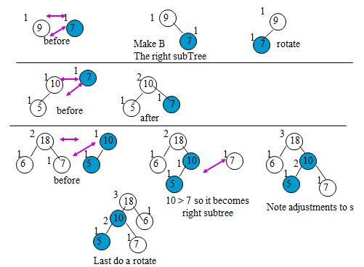
Melding Examples
Number outside is the s value, nodes from the B (right tree originally) are in blue

Slide 9
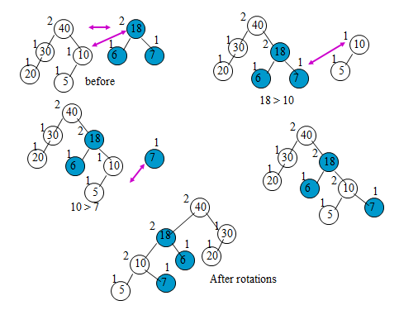
Another Melding Example

Slide 10
Basic Heap Operations
Op | Binary Heap | Leftist Heap | Binomial Queue | Fibonacci Heap
insert | O(lgN) | O(lgN)
deleteMin | O(lgN) | O(lgN)
decrease Key | O(lgN) | O(lgN)
merge | O(N) | O(lgN)
findMin | O(1) | O(1)

Slide 11
Amortized Time
Binomial Queues and Fibonacci Heaps have better performance in an amortized sense
Cost per operation vs. cost for sequence of operations
RB trees are O(lgN) per operation
Splay trees are O(M lgN) for M operations
Individual ops can be more/less expensive that O(lgN)
If one is more expensive, another is guaranteed to be less
On average, cost per op is O(lgN)

Slide 12
Binominal Queues
Although leftists heaps support merging , insertion and deletemin all in O(lg(n))(on average) can do better
Binomial queues support all of the operations in O(lg(n)) worst-case time and insertion is O(1) time.

Slide 13
Binomial Queues
Structural property
Forest of binomial trees with at most one tree of any height
Order property
Each binomial tree has the heap-order property

Slide 14
Binomial Queues Details
They are not a heap-oriented tree, but a collection of heap oriented trees called a forest.
Each tree is a binomial tree B_{k}
There is at most one binomial tree of every height, B_{k} is the binomial tree of height k.
B₀ is a single node
B_{k} is formed by attaching one B_{k-1} to the root of another B_{k-1}

Slide 15
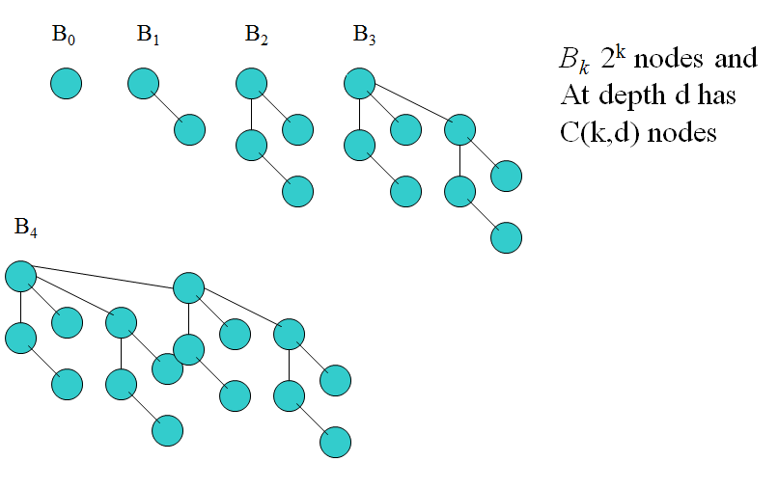
B_{k} Pictures

Slide 16
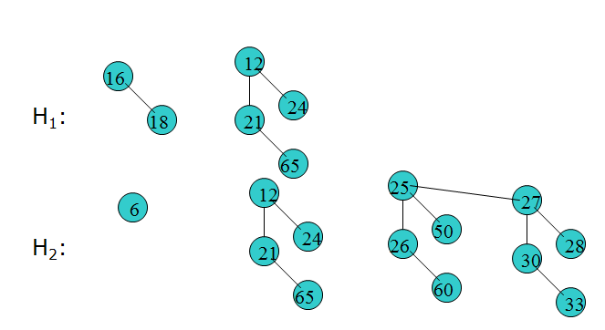
A Binomial Queue out of B_{k}
Any number of nodes can be represented by the appropriate forest. If there are n nodes, then use the binary representation of n to choose the appropriate B_{k} .
Consider 6 nodes. 6 = 110 ➔ 1 tree if size 4, 1 tree of size 2
Consider 13 nodes 13 = 1101 ➔ 8, 4 and 1

Slide 17
Basic Heap Operations
Op | Binary Heap | Leftist Heap | Binomial Queue | Fibonacci Heap
insert | O(lgN) | O(lgN) | O(1) amortized
deleteMin | O(lgN) | O(lgN) | O(lgN)
decrease Key | O(lgN) | O(lgN) | O(lgN)
merge | O(N) | O(lgN) | O(lgN)
findMin | O(1) | O(1) | O(1)

Slide 18
Basic Heap Operations
Op | Binary Heap | Leftist Heap | Binomial Queue | Fibonacci Heap
insert | O(lgN) | O(lgN) | O(1) amortized | O(1) amortized
deleteMin | O(lgN) | O(lgN) | O(lgN) | O(lgN) amortized
decrease Key | O(lgN) | O(lgN) | O(lgN) | O(1) amortized
merge | O(N) | O(lgN) | O(lgN) | O(1) amortized
findMin | O(1) | O(1) | O(1) | O(1) amortized

Slide 19
findMin
Scan trees and return smallest root
O(lgN) because there are O(lgN) trees
Keep track of tree with smallest root
Update due to other operations (e.g. insert, deleteMin)
O(1)

Slide 20
Code for a binomial tree
class BinomialNode
{
int data;
vector <BinomialNode *> ptrs;
};
class BinomialQue
{
private:
vector<BinomialNode *> roots;
}

Slide 21
Properties of Binomial Queue
At most one binomial tree of any height
n nodes ⇒ binary representation is of size ? ⇒ deepest tree has height ?
⇒ number of trees is ?
Define: height(forest F) = max_{tree T in F} { height(T) }
Binomial Q with n nodes has height Θ(log n)
O(log n)
Notes:
Binary representation lg(n)
Deepest tree is lg(n)
Number of trees is lg(n)

Slide 22
Operations on Binomial Queue
Will again define merge as the base operation
insert, deleteMin, buildBinomialQ will use merge
Insert() takes average 2….in particular, n inserts into an empty tree takes O(n). That’s as good as buildHeap!
Can we do increaseKey efficiently? decreaseKey?
increaseKey() – move down….but wait! Have to check all the children at every level to find the smallest …. suggests O(log n).
decreaseKey() – Same requirement as for binary heaps that it has external pointers to nodes. Move up through the tree, but need to add pointers to parents for every node to do this efficiently. O(log n)
What about findMin?
findMin() – this can be done by examining all roots of trees. Lg(n).
Yes! Just like Binary Heaps
log n normally
O(1) if you maintain min explicitly over ops

Slide 23
Merging Two Binomial Queues
Essentially like adding two binary numbers!
Combine the two forests
For k from 0 to maxheight {
m ← total number of B_{k}’s in the two BQs
if m=0: continue;
if m=1: continue;
if m=2: combine the two B_{k}’s to form a B_{k+1}
if m=3: retain one B_{k} and combine the other two to form a B_{k+1}
}
# of 1’s
0+0 = 0
1+0 = 1
1+1 = 0+c
1+1+c = 1+c
Claim: When this process ends, the forest has at most one tree of any height

Slide 24
Merging Two Binomial Queues
Merge Q1 and Q2, creating Q3
Q3 can contain only one B_{k} for each k
If only one of Q1 and Q2 contain a B_{k}, add it to Q3
What if Q1 and Q2 both contain a B_{k}?
Merge them and add a B_{k+1} to Q3
Now what if Q1, Q2, or both contain a B_{k+1}?
Merge until there are zero or one of them

Slide 25
Merging Two Binomial Queues
Think of Q1 and Q2 as binary integers
Bit k=1 iff queue contains a B_{k}
Compute Q3 = Q1 + Q2
To compute value of bit k for Q3
Add bit k from Q1 and Q2 and carry from position k-1
Adding bits corresponds to merging trees
May generate carry bit (tree) to position k+1

Slide 26
Merging Two Binomial Queues
Complexity is O(lgN)
There are O(lgN) trees in Q1 and Q2
Merging trees takes O(1)

Slide 27
Example: Binomial Queue Merge
Q1:
16
12
18
21
24
65
Q2:
13
14
23
26
51
24
65

Slide 28
Q1:
16
12
24
18
21
65
Q2:
13
14
23
24
26
51
65
Q3:

Slide 29
Q1:
16
12
24
18
21
65
Q2:
13
14
23
24
26
51
65
Q3:
13

Slide 30
Q1:
16
12
24
18
21
65
Q2:
13
14
23
24
26
51
65
Q3:
13
14
16
26
18

Slide 31
Q1:
16
12
24
18
21
65
Q2:
13
14
23
24
26
51
65
13
14
16
26
18

Slide 32
Q1:
16
12
24
18
21
65
Q2:
13
14
23
24
26
51
65
13
14
12
16
23
24
24
26
21
18
51
65
65

Slide 33
Another Example: Binomial Queue Merge
H1: H2:
21
1
-1
3
5
7
2
1
3
9
6
8
11
5
7
6

Slide 34
Another Example: Binomial Queue Merge
H1: H2:
1
-1
3
5
7
2
1
3
21
9
6
8
11
5
7
6

Slide 35
Another Example: Binomial Queue Merge
H1: H2:
1
-1
5
7
3
2
1
3
9
6
21
8
11
5
7
6

Slide 36
Another Example: Binomial Queue Merge
H1: H2:
1
-1
7
3
5
2
1
3
21
9
6
8
11
5
7
6

Slide 37
Another Example: Binomial Queue Merge
H1: H2:
-1
2
1
3
1
8
11
5
7
3
5
6
21
9
6
7

Slide 38
Another Example: Binomial Queue Merge
H1: H2:
-1
2
1
3
1
8
11
5
7
3
5
6
21
9
6
7

Slide 39
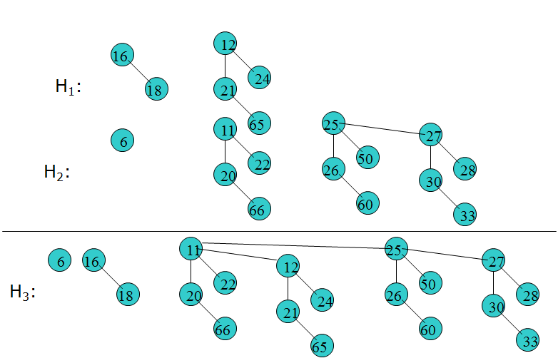
Another Example: Binomial Queue Merge
The main operation is merging. We just put like trees together pointing the larger root to the smaller root.

Slide 40
Inserting Binomial Queues
Insert value X into queue Q
Create binomial queue Q’ with B₀ containing X
Merge Q with Q’
Worst case O(lgN) because Q can contain lgN trees
Suppose B_{i} is smallest tree not in Q, then time is O(i)

Slide 41
Inserting Binomial Queues
Suppose probability that Q contains B_{k} for any k is 1/2
Probability that B_{i} is smallest tree not in Q is 1/2^{i} (why?)
The expected value of i is then:
∑i*(1/2i) = 2
On average, insertion will require a single merge and is therefore O(1) amortized

Slide 42
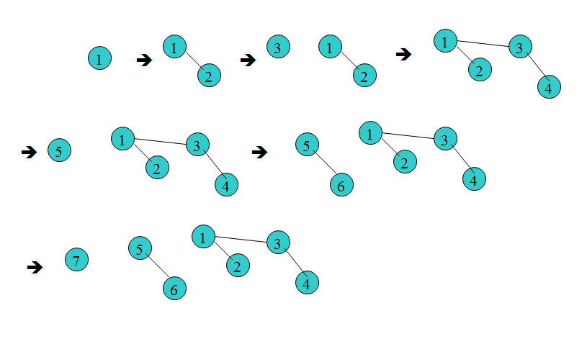
Inserting Binomial Queues
To insert, thus just make a single node and then merge
Example insert 1, 2, 3, 4, 5, 6, 7

Slide 43
Binomial Queues Implementation
Keep an array of pointers to each tree
To insert
note that ½ of the time it will take 1 probe.
Note the ¼ of the time it will take 2 probes
Note that 1/8 of the time it will take 3 probes
i.e. Expected time is for n insertions is < n.

Slide 44
Deletemin from a Binomial Queues
Find tree with minimum root and remove root
Treat sub-trees of root as a new binomial queue
Merge this new queue with the original one
O(lgN)

Slide 45
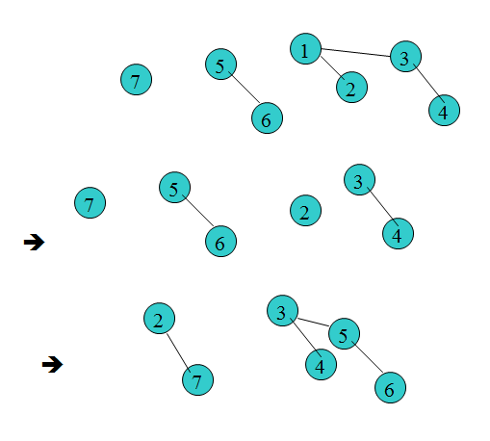
Example: deleteMin
Thus, to deletemin just check the root of each tree O(lg(n)) – 1 is minimum
Eliminate the root (1) and merge the remaining trees

Slide 46
Another Example: deleteMin
BQ
7
3
4
8
5
7
find and delete smallest root
How long does FIND take? O(log N)
merge BQ (without the shaded part) and BQ’
3
8
5
BQ’
Do merge on tablet before next slide
7

Slide 47
Another Example: deleteMin
Result:
7
4
8
5
7
Θ(log n)

Slide 48
Complexity of deleteMin
Theorem: The amortized running time of deleteMin is O(lgN)
Proof: It’s a bit tricky! But it’s in the text for those with burning curiosity.

Slide 49
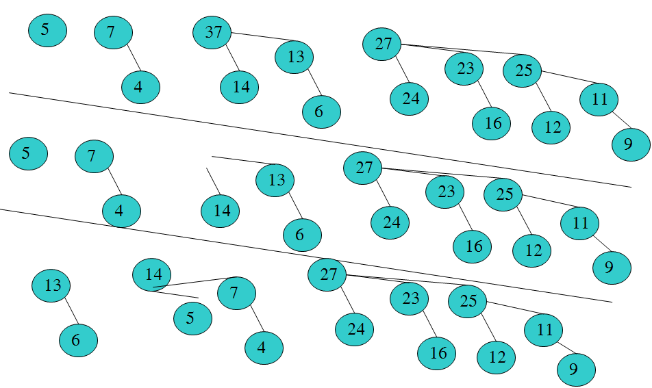
Show the result of DeleteMax

Slide 50
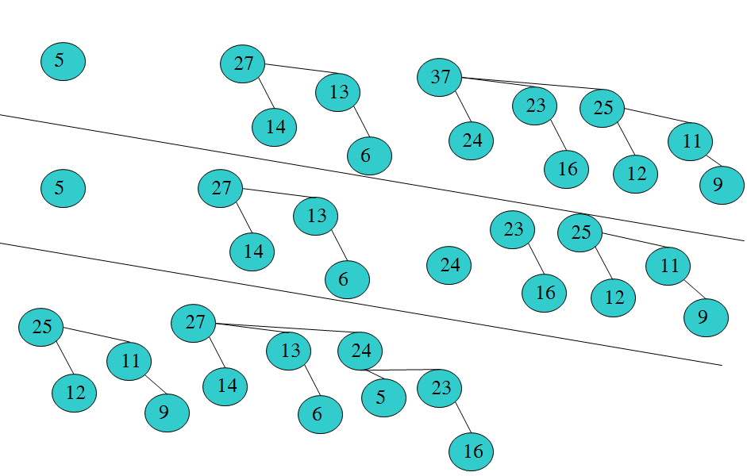
Show the result of DeleteMax

Slide 51
Fibonacci Heap
All heap operations take O(1) amortized time!
Except deleteMin, which takes O(lgN) amortized time
Implemented using Binomial Queue
Two new ideas
Lazy merging
New implementation of decreaseKey

Slide 52
Lazy Merging
To merge Q1 and Q2, just concatenate lists of Binomial Trees
This takes O(1) time
Result may contain multiple B_{k} for any given k (we’ll deal with this in a minute)
Insertion is now O(1) (why?)

Slide 53
deleteMin
Scan list of trees for one with smallest root
No longer guaranteed to be O(lgN) because of duplicate B_{k} from lazy merging
Remove root and lazily merge sub-trees with binomial queue
Reinstate binomial queue by merging trees to ensure at most one B_{k} for any k

Slide 54
Fibonacci Heap Example: deleteMin
5
6
3
10
9
15
21
4
7
11
8
18
20

Slide 55
Fibonacci Heap Example: deleteMin
Remove this node
5
6
3
10
9
15
21
4
7
11
8
18
20

Slide 56
Fibonacci Heap Example: deleteMin
More than one B₀ tree, merge
5
6
10
9
15
21
4
7
11
8
18
20

Slide 57
Fibonacci Heap Example: deleteMin
More than one B₁ tree, merge
5
6
10
9
15
21
4
7
11
8
18
20

Slide 58
Fibonacci Heap Example: deleteMin
5
6
10
9
15
21
4
7
11
8
18
20
Still more than one B₁ tree, merge

Slide 59
Fibonacci Heap Example: deleteMin
More than one B₂ tree, merge
6
9
15
21
4
7
11
5
8
18
10
20

Slide 60
Fibonacci Heap Example: deleteMin
6
7
9
15
8
18
21
4
20
11
5
10

Slide 61
Reinstating a Binomial Queue
R = rank of tree, number of children of root
L_{R} = set of all trees of rank R in queue
T = number of trees in queue
Code below is O(T + lgN) (why?)
for (R = 0; R <= lgN; R++)
while {|L_{R}| >= 2}
remove two trees from L_{R}
merge them into a new tree
add the new tree to L_{R+1}

Slide 62
decreaseKey
Standard approach is to change value (decrease it) and move up
Not O(1), which is goal, unless height of tree is O(1)
Instead, decrease value and then cut link between node and parent yielding two trees

Slide 63
Cut Example
3
15
9
21
Decrease key 15 to 1
3
3
1
1
Cut
9
9
21
21

Slide 64
Cascading Cuts
When cutting, do the following
Mark a (non-root) node the first time that it loses a child due to a cut
If a marked node loses another child, then cut it from its parent. This node becomes the root of a separate tree that is no longer marked. This is called a cascading cut because several could occur due to a single decreaseKey.

Slide 65
Cascading Cuts Example
3
5
10*
33*
13
Parts of tree not shown
Nodes with * marked
Decrease 39 to 12
35
39
41
46

Slide 66
Cascading Cuts Example
3
5
10*
33*
13
Decrease value
Cut from parent
35
12
41
46

Slide 67
Cascading Cuts Example
3
5
10*
33
13
35
12
Marked node (33) lost second child
Cut from parent and unmark
41
46

Slide 68
Cascading Cuts Example
3
5
10
33
13
35
12
Marked node (10) lost second child
Cut from parent and unmark
41
46

Slide 69
Cascading Cuts Example
3
5*
10
33
13
35
12
Unmarked node (5) loses first child
Mark it
41
46

Slide 70
Reinstate the Binomial Queue
3
5*
10
33
13
35
12
restructure to shape (e.g. 3 nodes to 2 and 1)
merge
41
46

Slide 71
Basic Heap Operations
Op | Binary Heap | Leftist Heap | Binomial Queue | Fibonacci Heap
insert | O(lgN) | O(lgN) | O(1) amortized | O(1) amortized
deleteMin | O(lgN) | O(lgN) | O(lgN) | O(lgN) amortized
decrease Key | O(lgN) | O(lgN) | O(lgN) | O(1) amortized
merge | O(N) | O(lgN) | O(lgN) | O(1) amortized
findMin | O(1) | O(1) | O(1) | O(1) amortized

